Slide 1
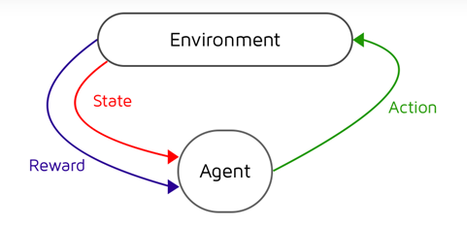
SOC PRESNTATION Markov Decision Processes VS Contextual Bandits
SAKSHAM Rathi

Slide 2
Markov decision Processes
Temporal extension of bandit problems
Pulling an arm influences the future rewards
Concept of state
Involved in decision making of a dynamic system
Results either random or controlled by a decision maker making sequential decisions
Elements = Agents, States, Actions, Rewards and Optimal policies

Slide 3
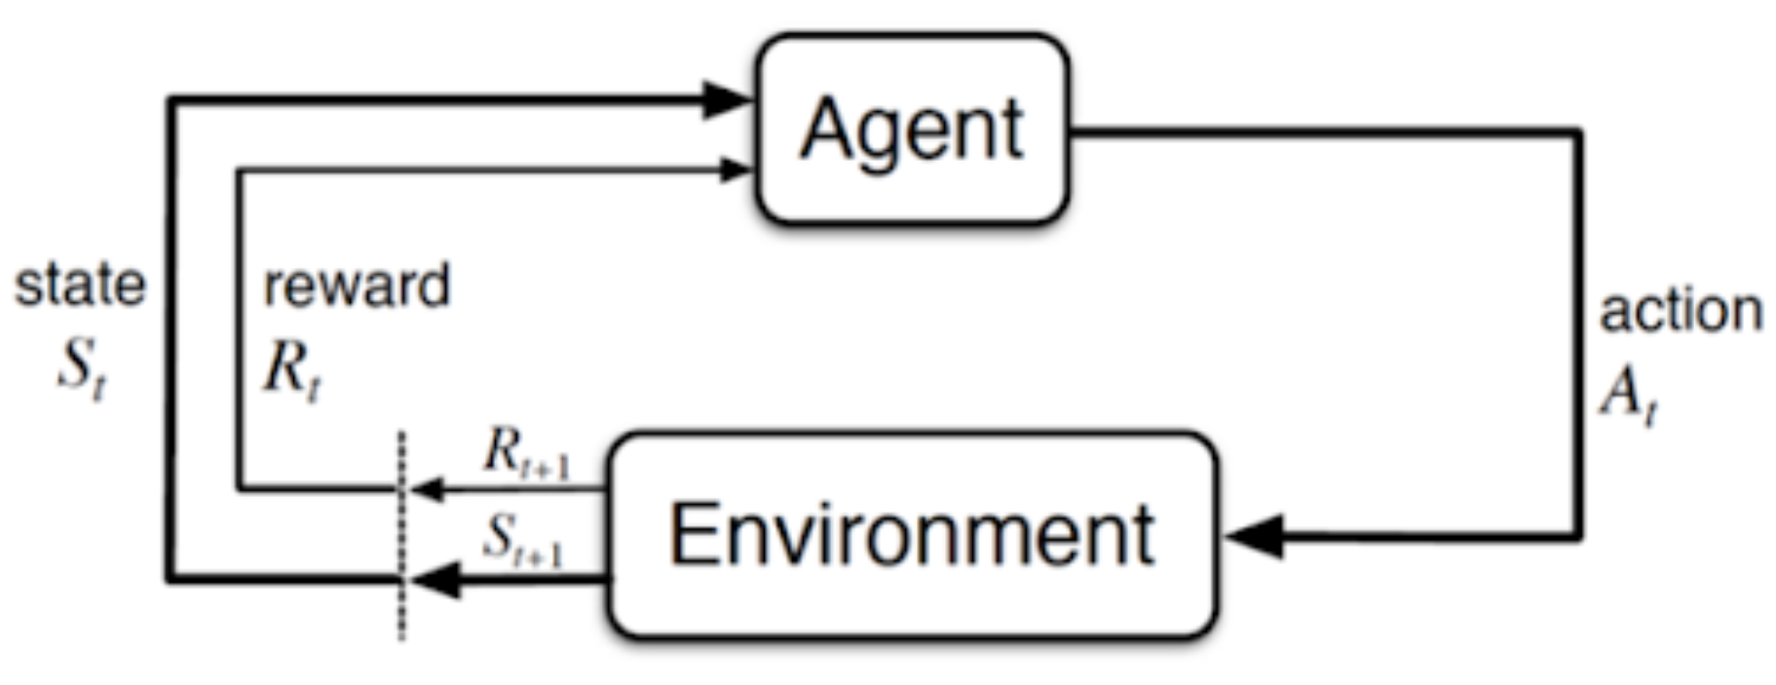
Graphical model of mdps

Slide 4
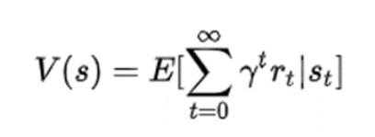
POLICY AND VALUE
Policy (Π) is a function from states to actions. Goal = maximize the rewards.
Discounted factor (γ) = If γ close to zero, then focus on immediate rewards. If γ closer to one, then long-term rewards are prioritized.
Value function gives the reward return at each specific state.

Slide 5
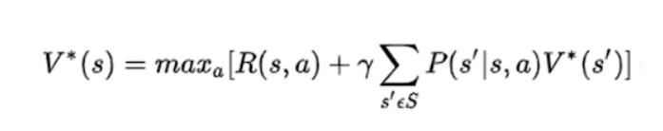
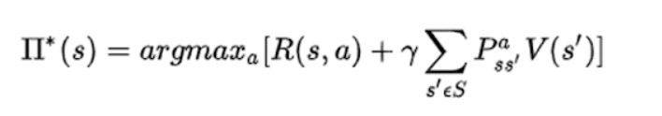
Value Function
Two components
Reward of current state
Discounted reward of the next state

Slide 6
Some algorithms in brief
Value Iteration = Starts with an initial value estimate and iteratively updates the values until convergence.
Policy Iteration = Initial Policy, evaluate and improve
Q-Learning = Learns the optimal action-value function. Exploration – exploitation strategy, iteratively update Q values
Monte Carlo methods = Estimate the value function by averaging the observed returns obtained through random exploration.

Slide 7
APPLICTIONS OF MDPS
Proportion of salmons to catch in a year in a specific area maximizing the longer term return
Quiz game show= Higher the level. Tougher the question but higher the reward
Reducing wait time at a traffic intersection
How many patients to admit

Slide 8
CONTEXTUAL BANDITS
Rewards in each round depend on a context, which is observed by the algorithm prior to making a decision.
Problem Protocol:
Algorithm observes a context x_{t}
Algorithm picks an arm a_{t}
Reward r_{t} is realized
The above steps are executed for each round t.

Slide 9
What’s the difference?
Contextual Bandits
Markov Decision Processes
Goal = To maximize the cumulative rewards
Immediate feedback, feedback does not depend on the chosen action’s impact on future states.
Actions based on current context.
Generally used for short-term rewards.
Goal = To find the optimal policy
Feedback may be delayed. Depends on the entire sequence of actions taken.
Actions based on current and previous states. Sometimes the current state contains the information of the previous states too.
Generally used for long-term dynamic systems.

Slide 10

TYPES
Lipschitz
Linear
Policy class

Slide 11


